Slide 1


Group number 1
Faisal, Amjad, Raghad , Sarah

Slide 2
mission
To build a program using machine learning model to predict store sales based on a given dataset

Slide 3
Steps of buld the model
01
02
Discover the data
Prepare the data
03
04
Choose a model
Train the model

Slide 4

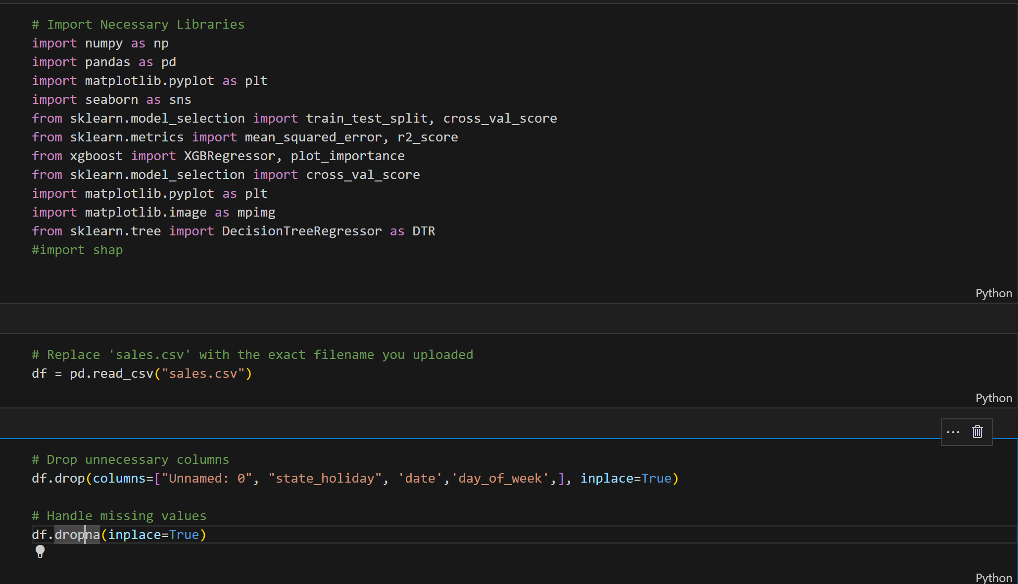
Download the necessary libraries & Datasets

Slide 5
Prepare the data
Remove the unnecessary columns
Checking for any missing values

Slide 6
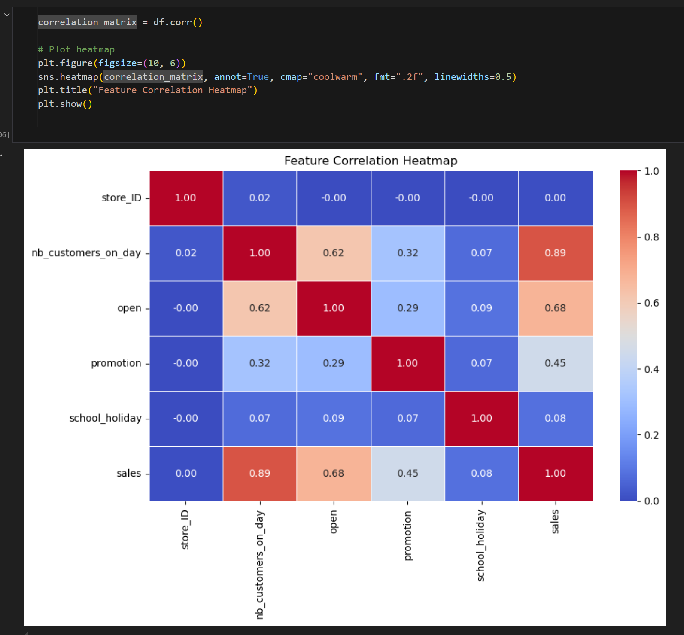
Correlation matrix
This help us to identify the relationships between variables and which feature are useful for modeling

Slide 7
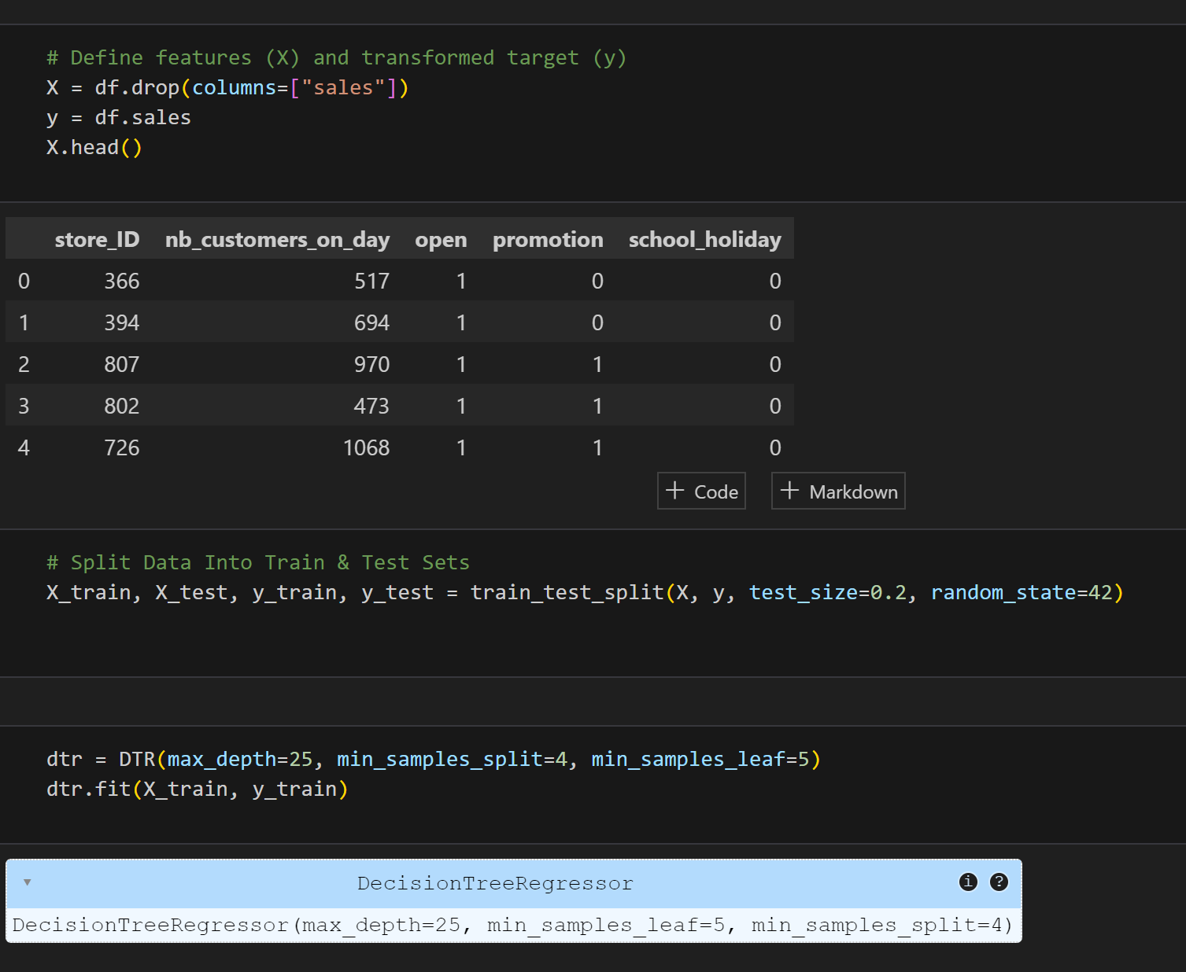
Split the data
By defining X and Y then split the data into 80% training and 20% testing

Slide 8
Split the data
Trains a Decision Tree Regressor model with hyperparameters that we settle down on it
max_depth=25 → Limits the tree depth to 25 levels to prevent overfitting.
min_samples_split=4 → A node must have at least 4 samples before it can be split.
min_samples_leaf=5 → A leaf node must contain at least 5 samples, preventing small, overly specific splits.
Fit the X_train, y_train on our Model

Slide 9
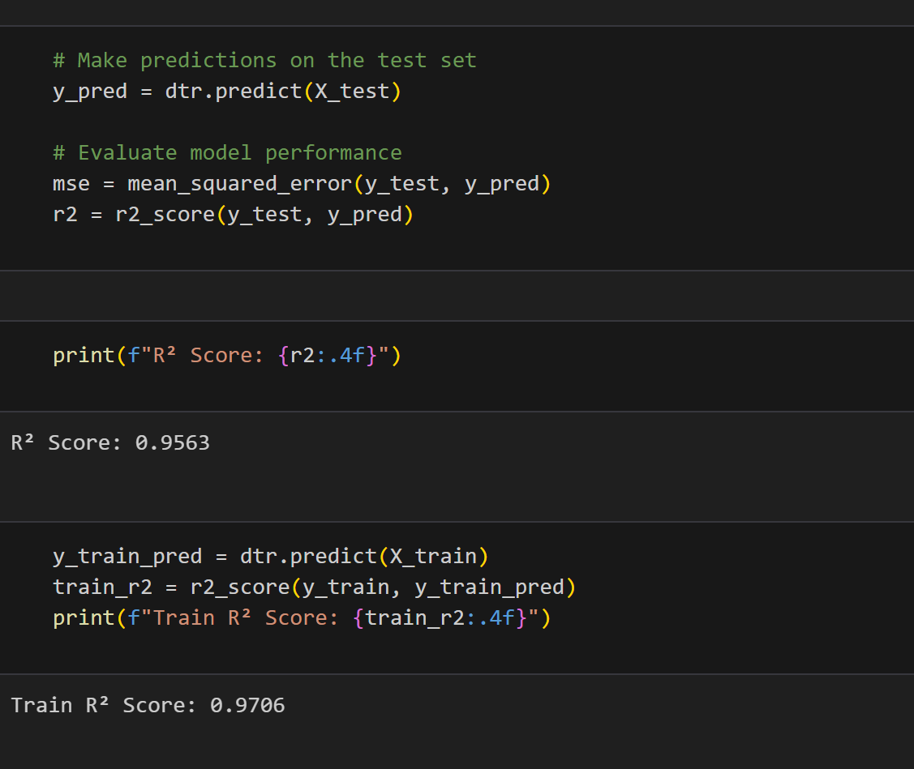
Test R² Score: 0.9563 Train R² Score: 0.9706

Slide 10
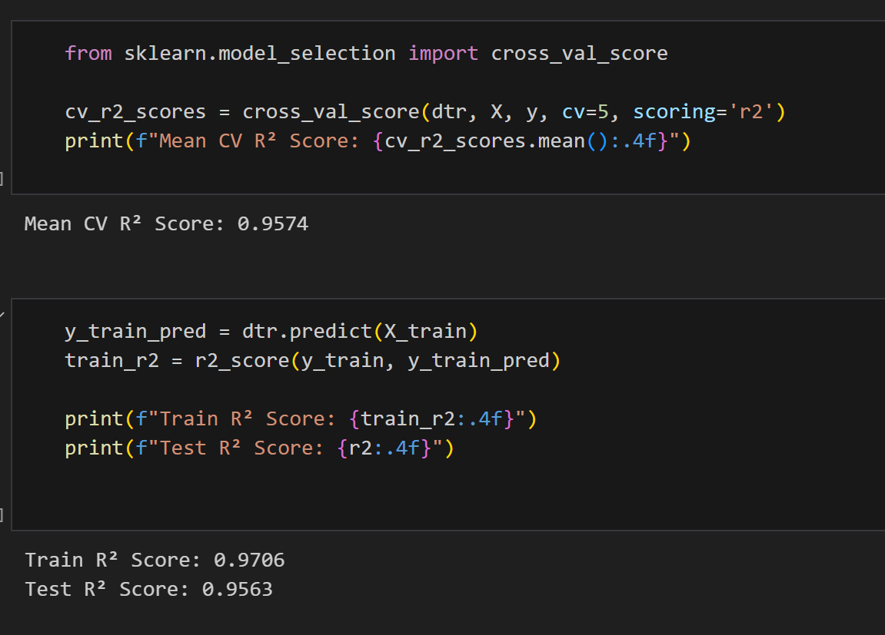
Cross validation & comparison
Mean CV R² Score: 0.9574
Test R² Score: 0.9563 Train R² Score: 0.9706

Slide 11
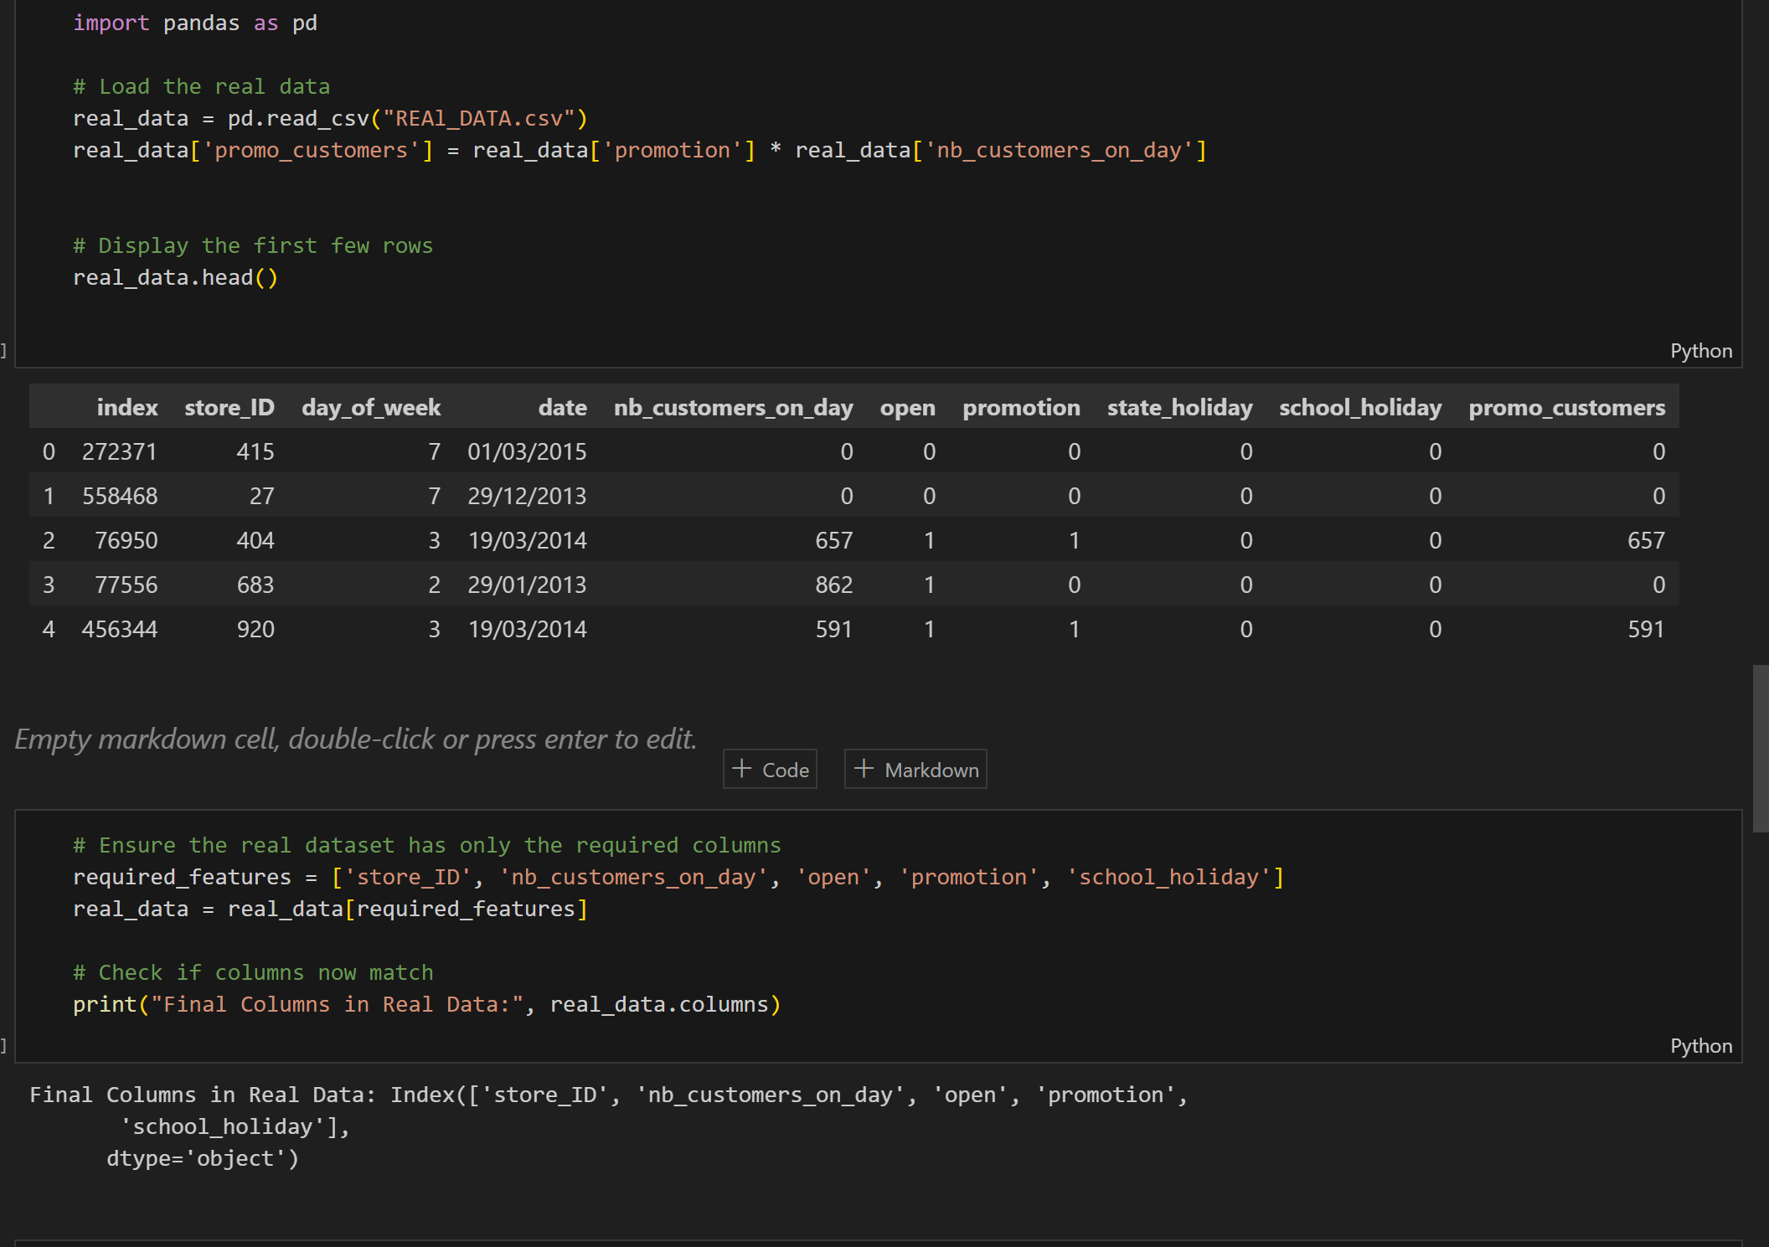
Trying our model
By downloading the real data file & make sure that the columns are matching in both datasets

Slide 12
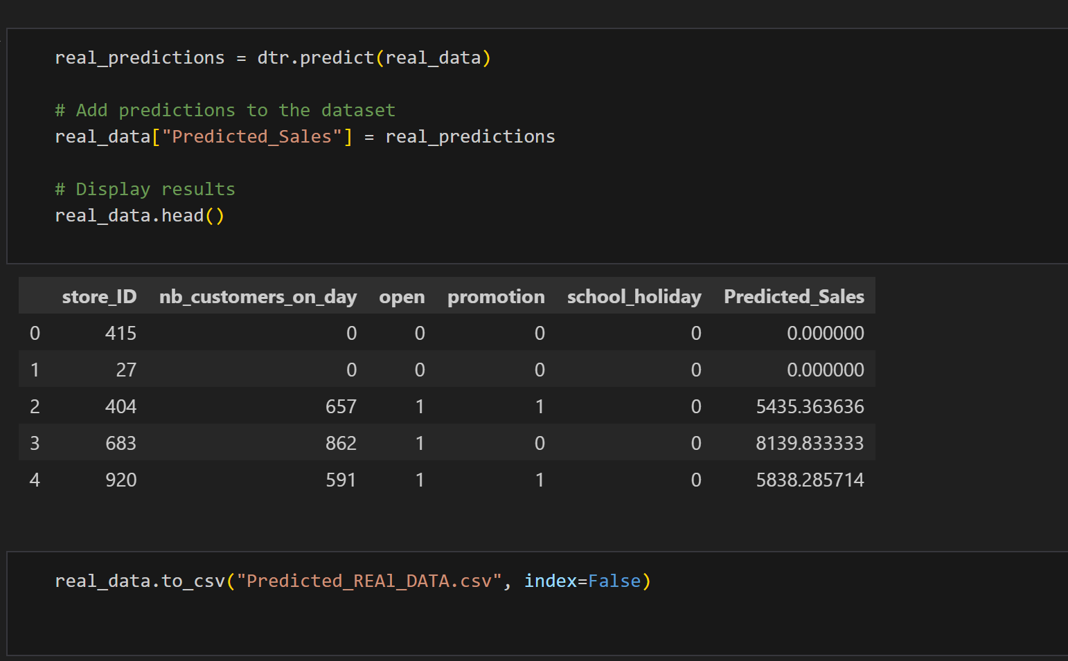
Adding the predictions

Slide 13
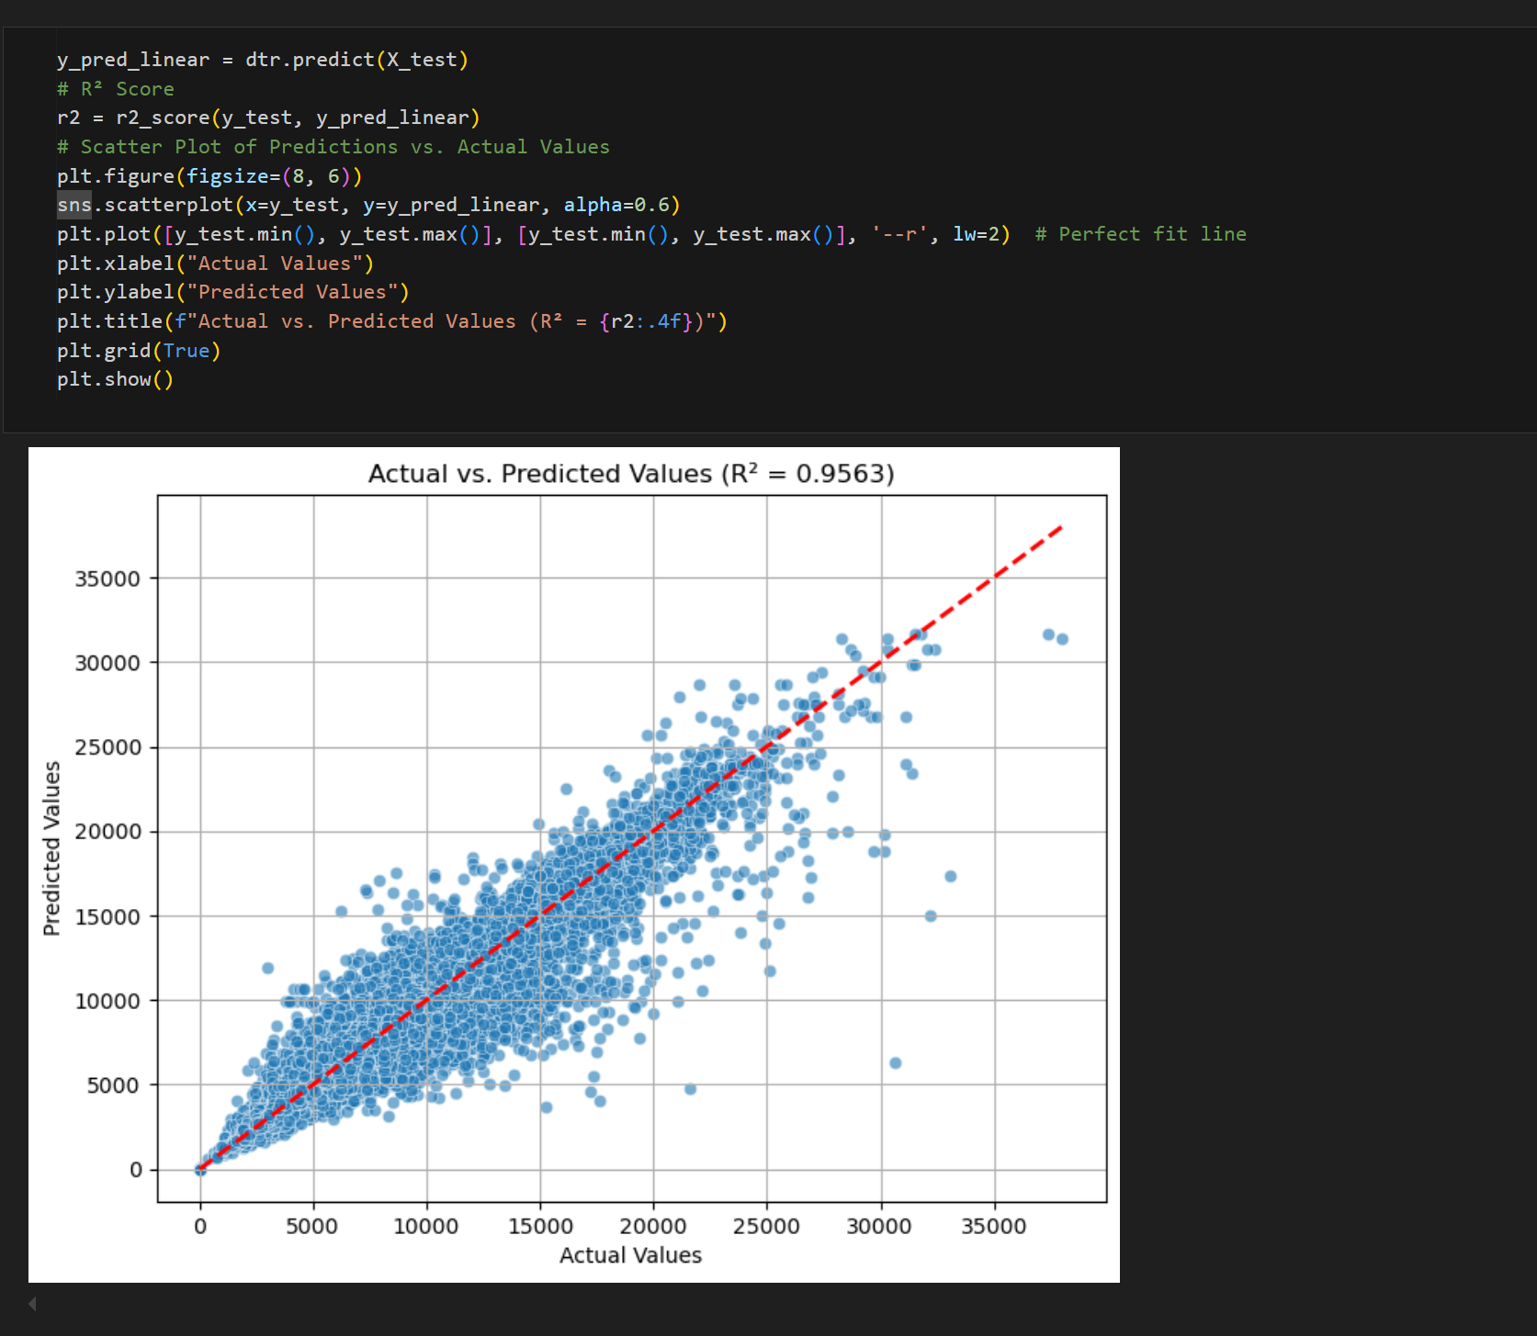
Scattered plot of
Actual values
Vs
Predicted Values

Slide 14
Thank you

